Slide 1

Asian & Pacific Islander National Cancer Survivors Network: Cancer Strategies to Reach Underserved AAs and NHPIs Trish Quema, MPA(c) Community Engagement Specialist February 20, 2014

Slide 2
APINCSN Background
Challenges
APINCSN initiatives
Strategies to engage with AAs and NHPIs
Q & A

Slide 3
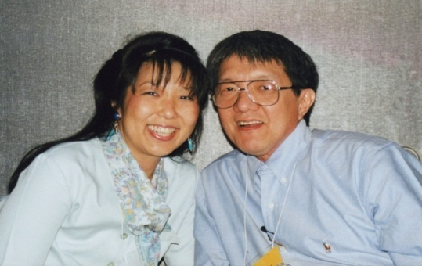
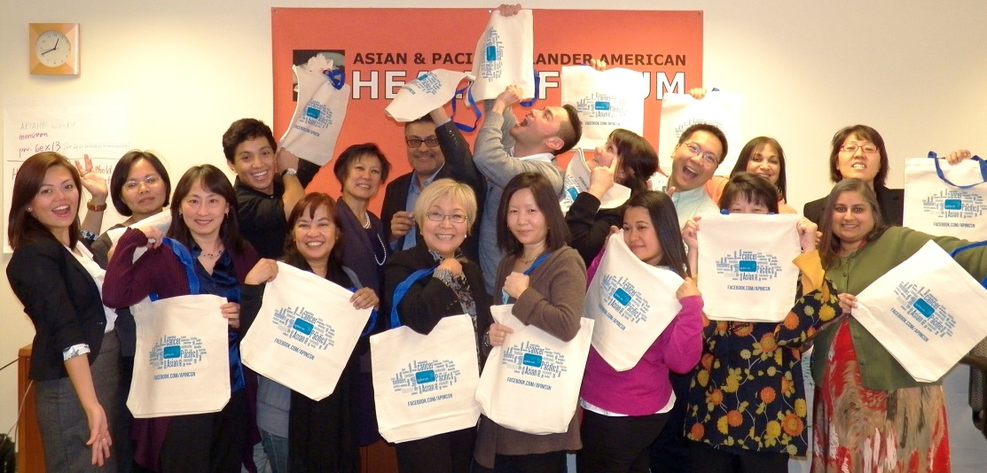
Asian & Pacific Islander National Cancer Survivors Network (APINCSN) www.apincsn.org
APINCSN is a network of cancer survivors, their family members, health care providers, researchers, health advocates, community members and organizations concerned about cancer and survivorship in the AA and NHPI communities.
Co-founded in 1998 by cancer survivors Susan M. Shinagawa and the late Rev. Frank Chong
Please join the Network if you are not a member yet!
www.apiahf.org/apincsn/membership

Slide 4
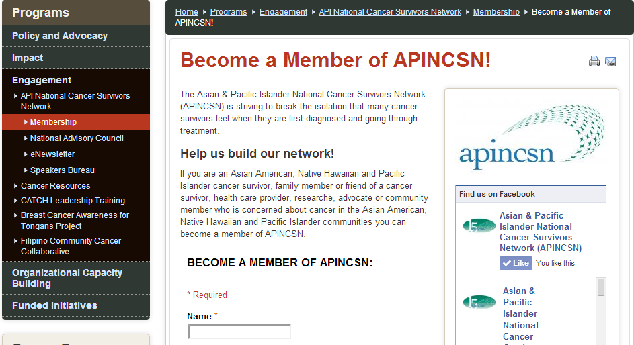
APINCSN Membership
A total of 1153 individuals and organizations are currently members of the APINCSN.

Slide 5
APINCSN stakeholders
AA and NHPI cancer survivors & their family members
Health care providers
AA and NHPI community-based organizations addressing cancer and cancer survivorship;
Researchers
AA and NHPI cancer support group facilitators;
Cancer advocates
Cancer programs at local, state, and Pacific Island Jurisdictions health departments.

Slide 6

Challenges
Lack of health coverage and access
Lack of linguistically and culturally competent care
Insufficient data collection
and reporting
Cultural beliefs that
complicate the diagnosis and treatment of cancer

Slide 7
How do we address these challenges?
CATCH Trainings to improve delivery of services and increase awareness of issues faced by cancer survivors.
Supporting cancer survivors by providing access and referrals to: cancer resources and in-language materials, peer and community support, and survivorship services
Advancing awareness through data and communications opportunities –among the general public, policy makers, survivors, providers, and others of cancer survivorship and its impact.
Responding to technical assistance requests

Slide 8
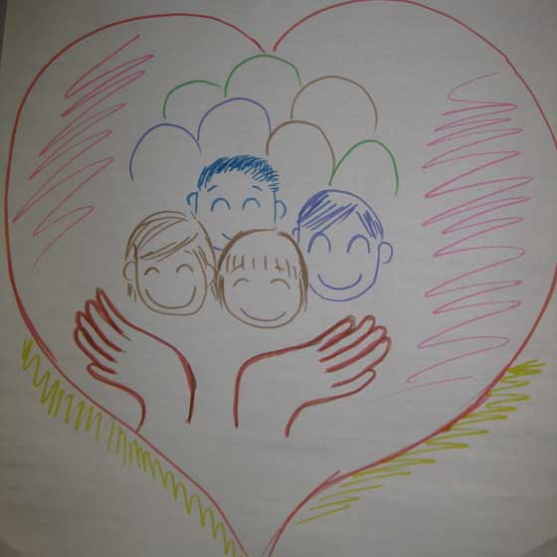
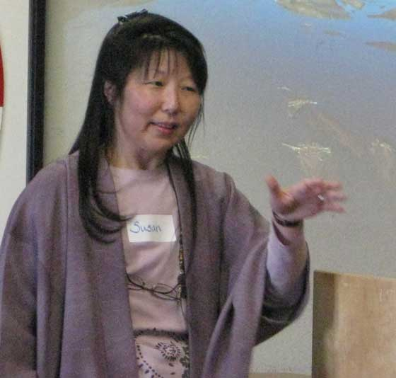
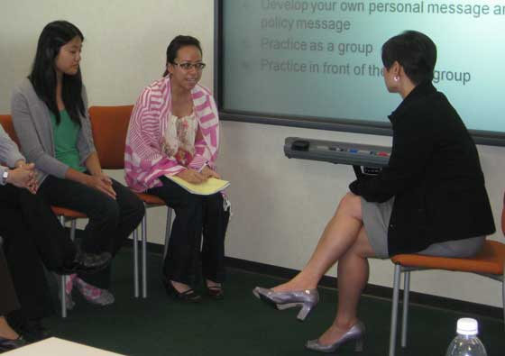
Community Advocacy & Training on Cancer and Health (CATCH) Training
DAY 1
DAY 2
DAY 3
*Module I: Intro to AA & NHPI Communities
Cancer 101 in AAs & NHPIs
Module III:
Data 101
Module V:
Ethnic –and Language–Specific AA & NHPI Cancer Support Groups
Module II:
Communications on Cancer and Social Media
Module IV: Policy & Civic Engagement

Slide 9
Outreach
 | LOCATION | PARTNER ORGANIZATION | # TRAINED | DATE
1. | San Jose, CA | Yu-Ai Kai | 27 | May 1- 3, 2009
2. | Orange, CA | St. Joseph Comprehensive Cancer Center | 20 | July 9 – 11, 2009
3. | Philadelphia, PA | American Cancer Society – PA | 20 | Nov. 6 – 8, 2009
4. | Phoenix, AZ | Asian Pacific Communities in Action | 27 | April 8 – 10, 2010
5. | Minneapolis, MN | Minnesota Cancer Alliance & Vietnamese Social Services of MN | 30 | March 24 – 25, 2011
6. | Houston, TX | Asian American Health Coalition and Hope Clinic – Light and Salt Association | 24 | April 14 – 16, 2011
7. | Cleveland, OH | Asian Services in Action | 18 | Nov. 17-19, 2011
8. | Salt Lake City, UT | National Tongan American Society | 27 | May 2-4, 2012
9. | Salt Lake City, UT | National Tongan American Society - CATCH TOT | 37 | May 15-17, 2013
10. | Kona, Hawai’i | Department of Health Comprehensive Cancer Control Program and the Office of the Mayor, Hawai’i County | 28 | June 19-21, 2013
 | TOTAL |  | 258

Slide 10
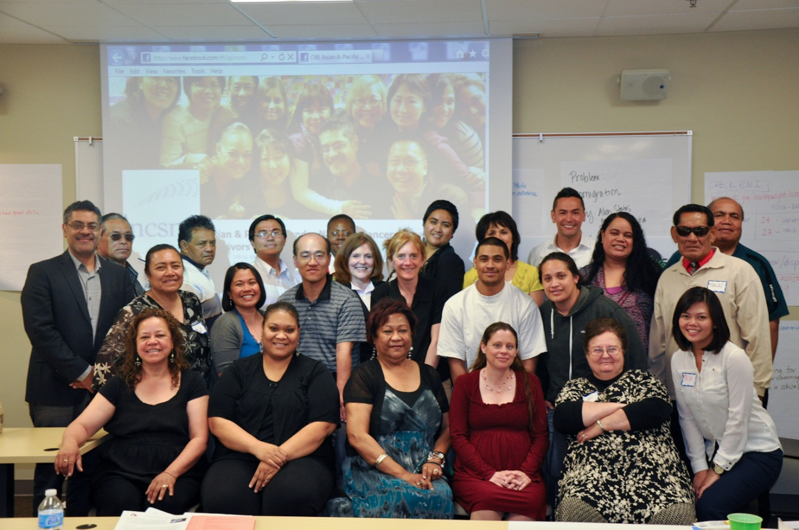
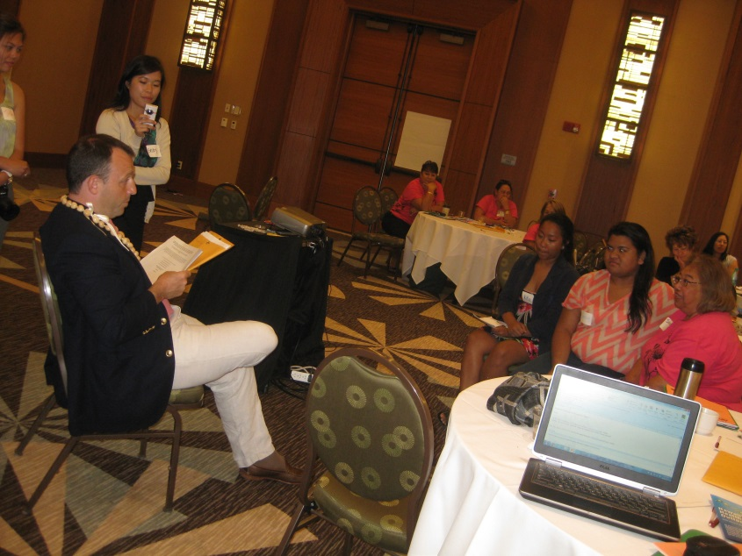
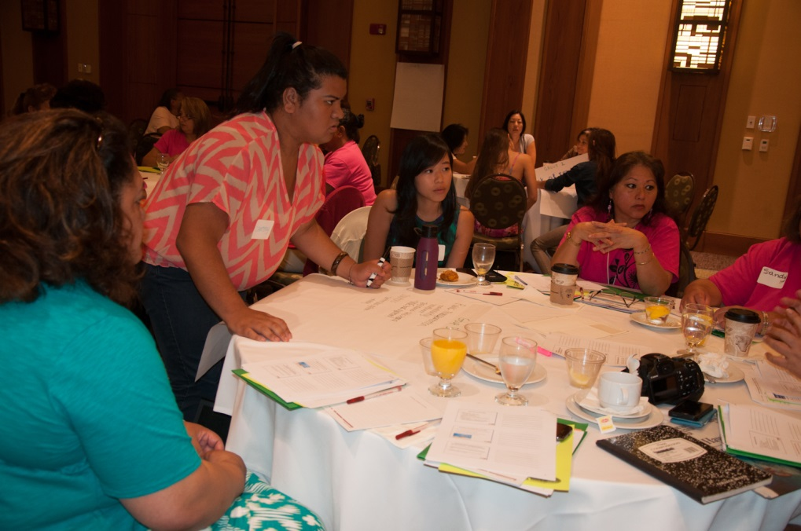
CATCH
10

Slide 11
CATCH Training of Trainers (TOT)
37 trainees from 21 organizations representing 9 states: CA, WA, PA, OH, AZ, TX, MI, NY, UT .
18 organizations applied for mini-grant funding of $500 to support projects in cancer education, awareness, and survivorship.
These projects reached over 1600 individuals.
11

Slide 12

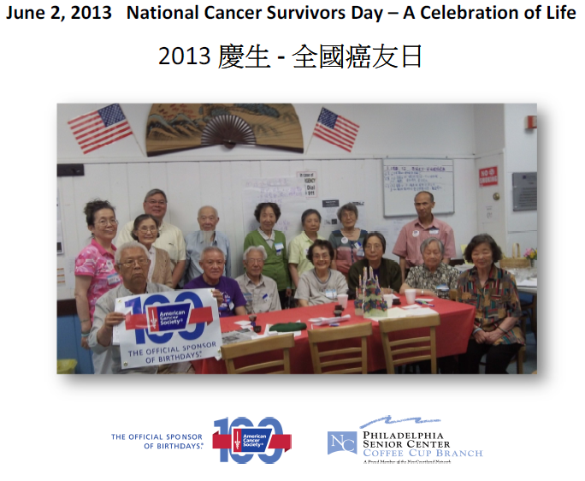
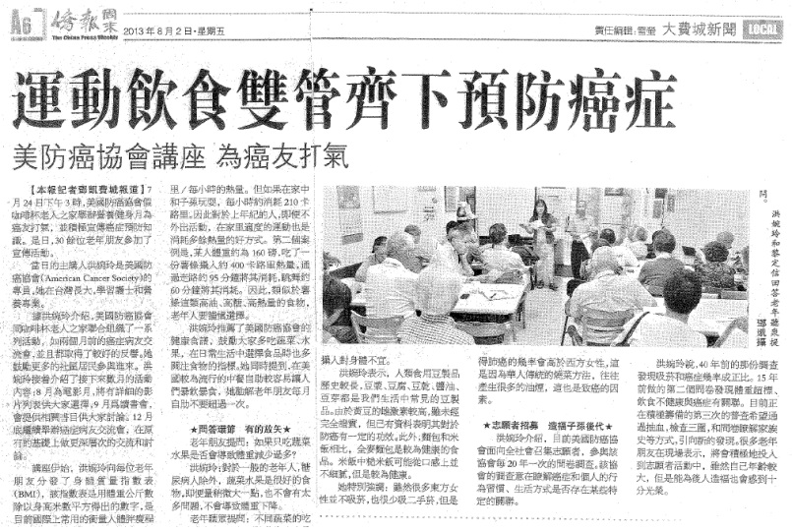
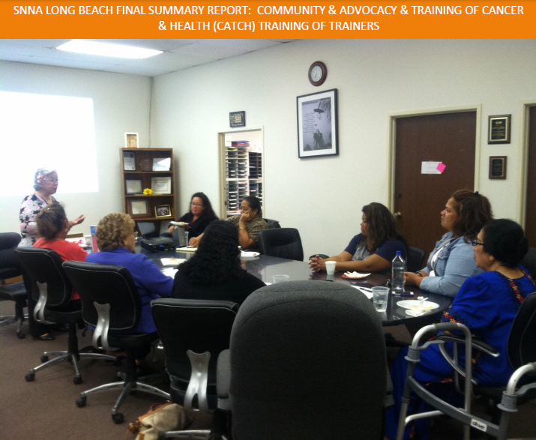
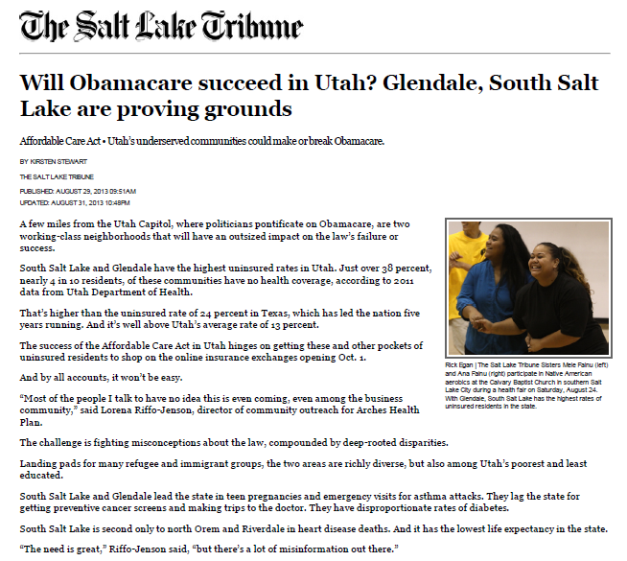
12

Slide 13
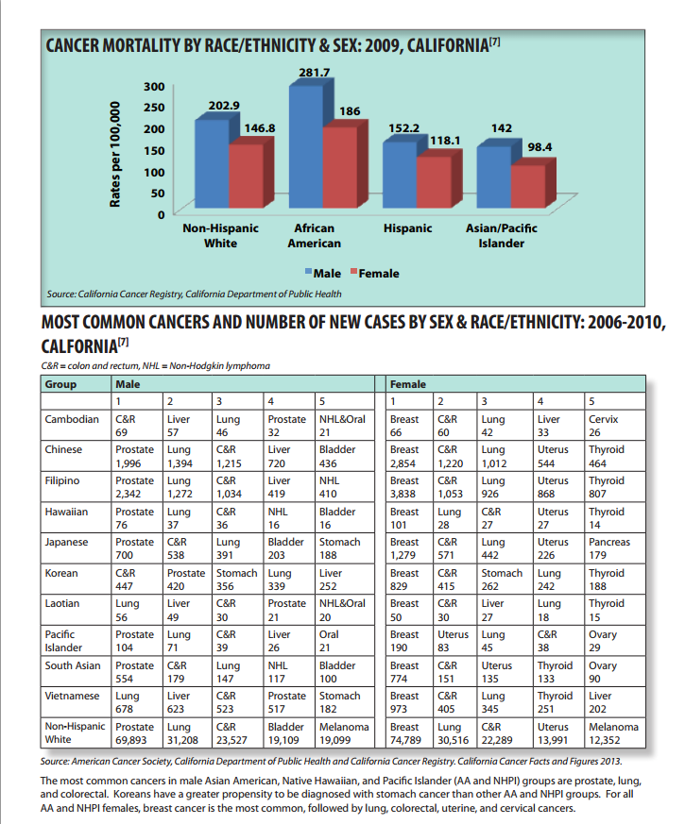
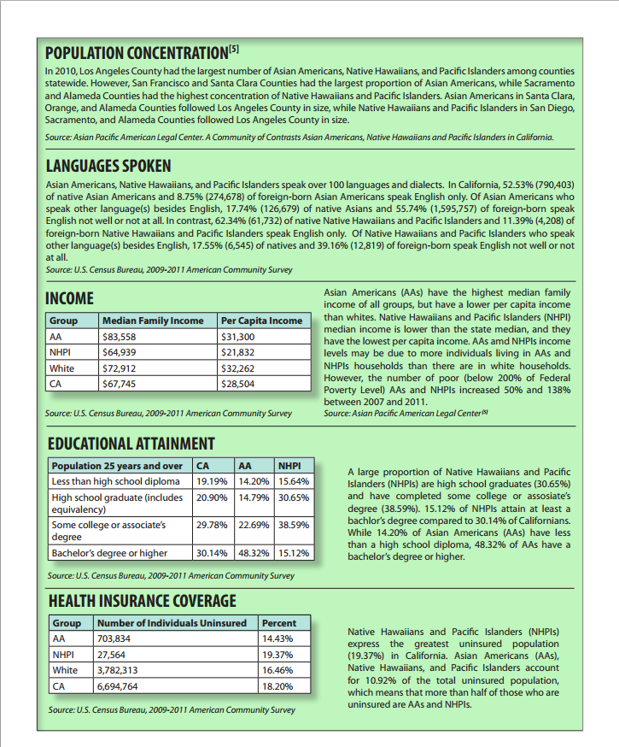
Cancer Health Briefs
Access 21 health briefs here: http://bit.ly/CancerHealthBriefs
13

Slide 14


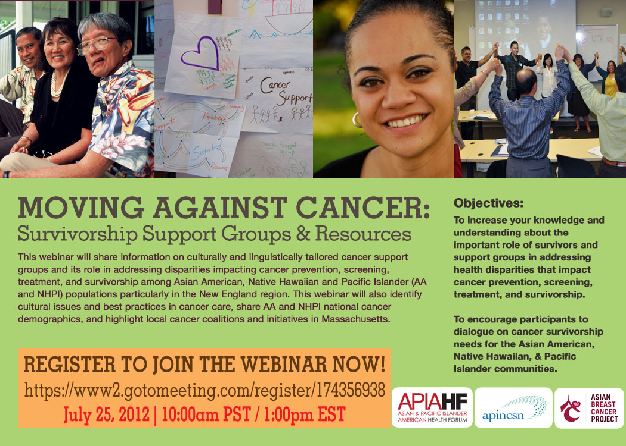
Moving Against Cancer Webinar Series
14

Slide 15
Technical assistance
Tailored cancer education materials (translations)
Program planning and support
Resource referrals & navigation
Cancer support groups
Speaking engagements, presentations
Promoting advocacy and leadership
200+
TA hours
15

Slide 16
What are specific strategies to engage with AAs and NHPIs?
16

Slide 17
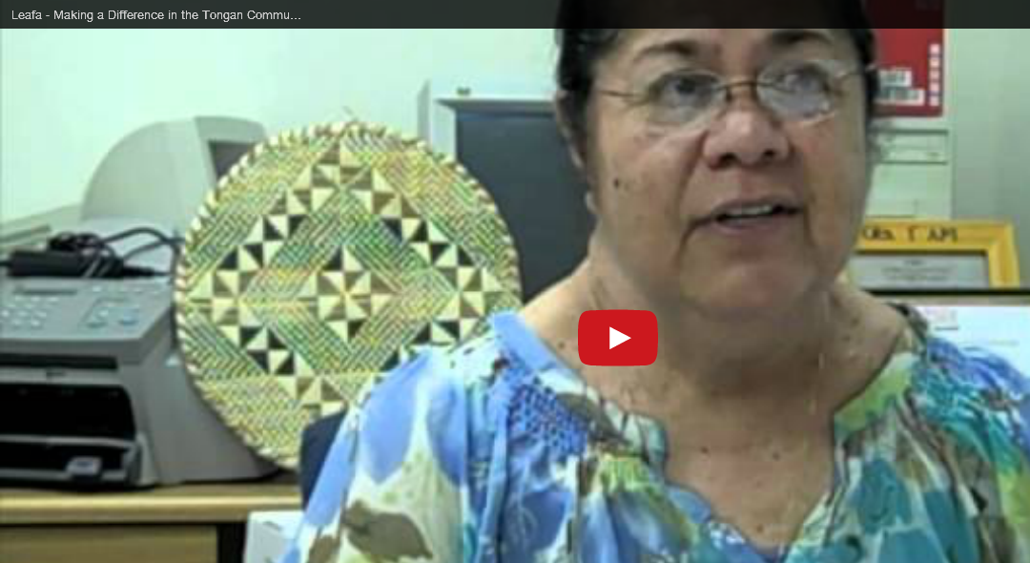
Identify leaders in the community
Leafa youtube video (3 mins)
http://www.youtube.com/watch?v=WOaKtrcjILQ
17

Slide 18
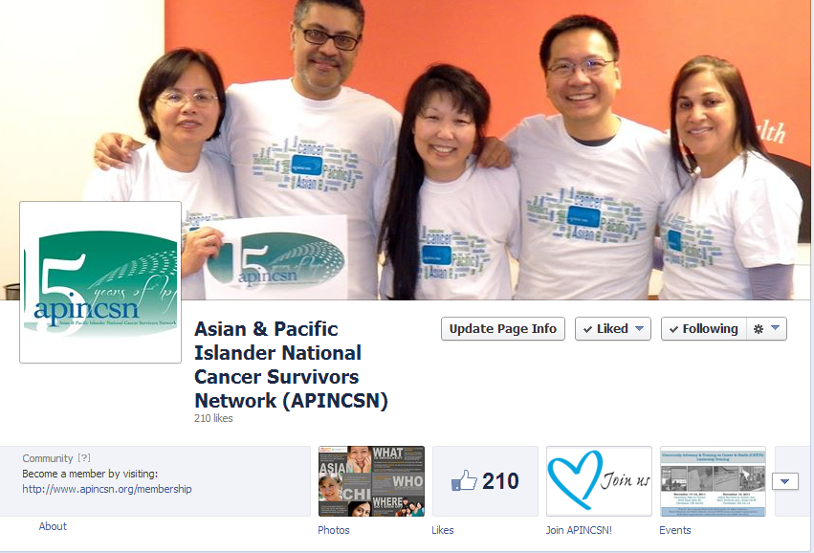
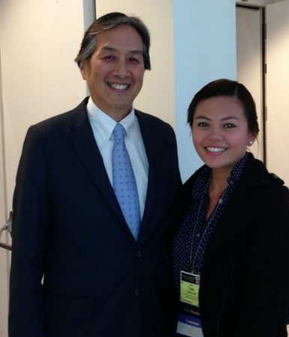
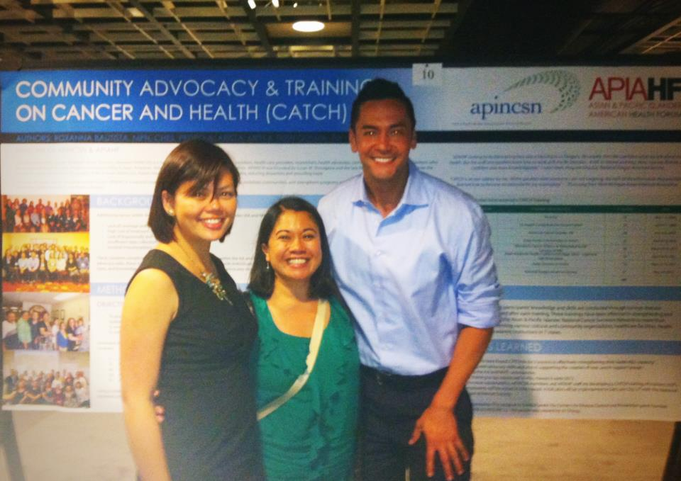
Promote your brand
18

Slide 19
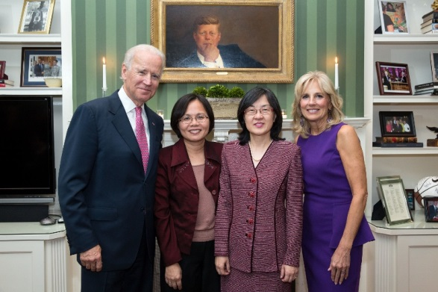
Have vocal and visible leaders
19
Notes:
SMS – President’s cancer panel

Slide 20
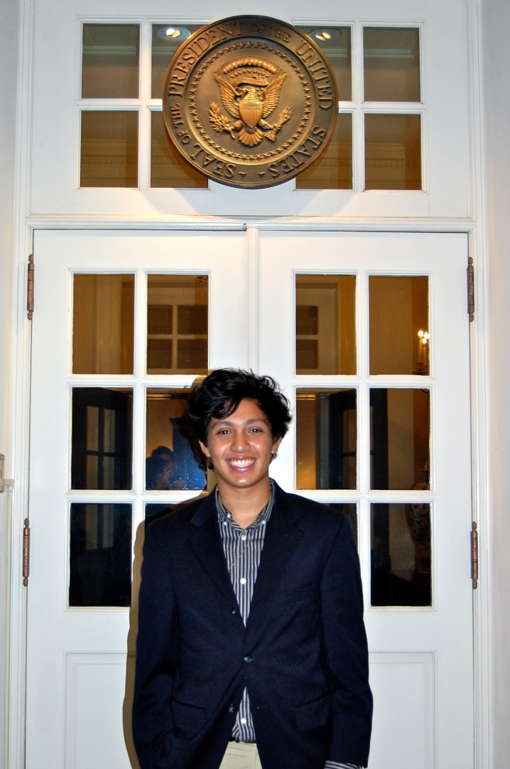
Tell their story
“Before health care reform, I was unable to afford my prescription medications because my cancer medications were not on my insurer's approved drug list. The drugs I must take to treat my cancer cost $40+ per capsule and I presently take 4 per day, though this may soon increase to 6. At present, the cost of my medication is nearly $5,000 per month, or $60,000 per year. Despite knowing that this medication was necessary to save my life, [my previous insurer] repeatedly declined further support. My parents, of course, did whatever they could to find the funds to pay for my treatments. ln fact, my father sold our family home, which he had lived in for 50 years, to make certain we had the money for my medicine.
Health care reform is important to me because thanks to [the Affordable Care Act], we were able change insurers. We now have insurance that covers much more of my prescription costs. I will also be able to remain on my parents' health insurance up to age 26.”
http://www.youtube.com/watch?v=C3M7kPnUVWY
20

Slide 21
Promote partnerships
21

Slide 22
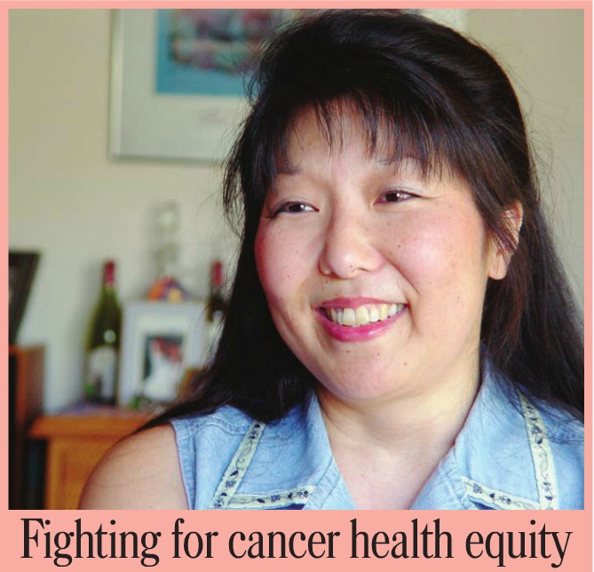

Work with your local media
22

Slide 23
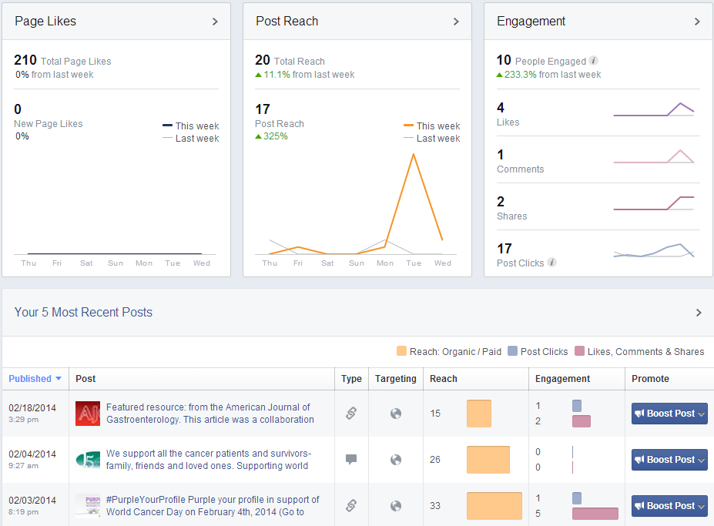
Track your effectiveness
23

Slide 24

Show everyone how to follow
http://www.youtube.com/watch?v=fW8amMCVAJQ
24

Slide 25
Thank You!
Contact us: Trish: tquema@apiahf.org, (415) 568-3330 Rox: rbautista@apiahf.org, (415) 568-3304
www.facebook.com/apincsn
www.apincsn.org
25

